Slide 1




TP
TRACER PAY
Next-Generation Payment Gateway Solutions
Seamless Payment Solutions
Tailored for Your Business
Transform your payment processes with cutting-edge technology,
interchange optimization, and dedicated service
Interchange Optimization
Advanced Security
Modern Interface
Maximize Level 2 & 3 savings
3D Secure & fraud protection
Clean, intuitive design
Comprehensive Payment Gateway Solutions for ISOs, Processors & Merchants

Slide 2




The Payment Processing
Challenge
Merchants are losing profits to outdated systems and hidden fees
2-3.5%
Rising Interchange Costs
Average interchange fee per transaction
Interchange fees reached
in 2021,
with a 19.1% increase from the previous year
$31.59 billion
70-80%
Of total processing costs are interchange fees
Outdated Interfaces
Merchants struggle with clunky, confusing gateways that
slow down operations and frustrate users
$96,000
Annual cost for 1,000 monthly transactions at $400 average
Transaction Downgrades
Poor processes result in downgrades, causing merchants
to pay higher fees unnecessarily
Costs Continue Rising
Without optimization strategies
The Problem:
Traditional payment processors offer limited transparency,
outdated technology, and minimal optimization—costing merchants thousands annually

Slide 3

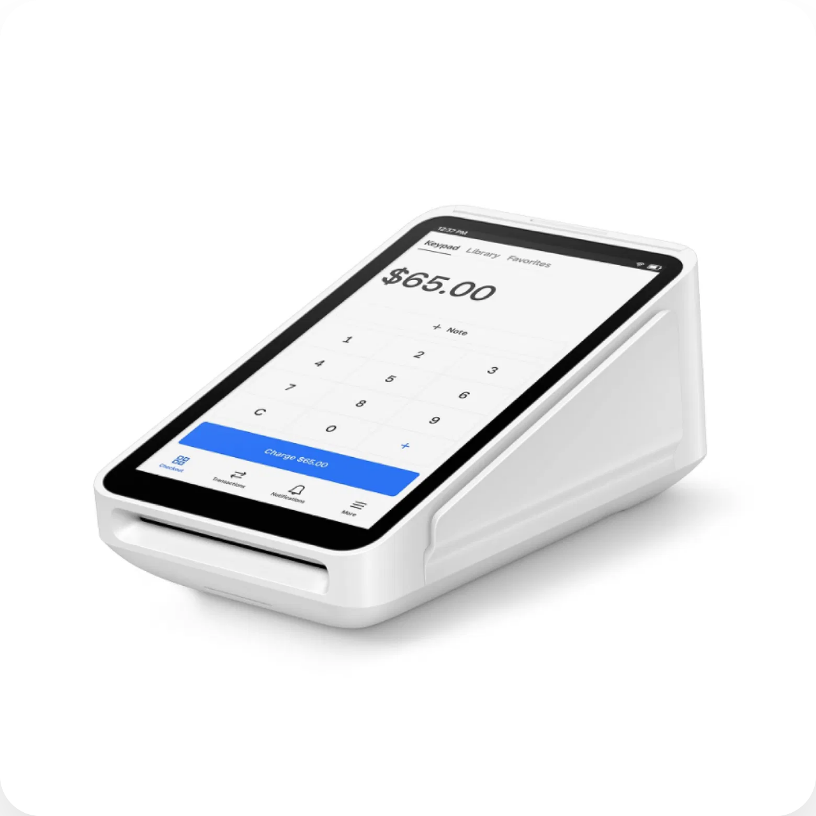




TracerPay
Solution Overview
A comprehensive payment gateway designed for modern businesses
Complete Payment Ecosystem
Interchange Optimization
Automated Level 2 & 3 data transmission for maximum savings
Modern Interface
Clean, intuitive design that merchants actually want to use
Advanced Security
3D Secure, fraud protection, and PCI Level 1 compliance
All-in-One Platform
Credit cards, ACH, recurring payments, and invoicing
Modern Payment Technology
One Gateway. Every Payment Need.
Eliminate the need for multiple vendors
9
10
100%
24/7
Core Features
Fraud Modules
White Label
Support

Slide 4


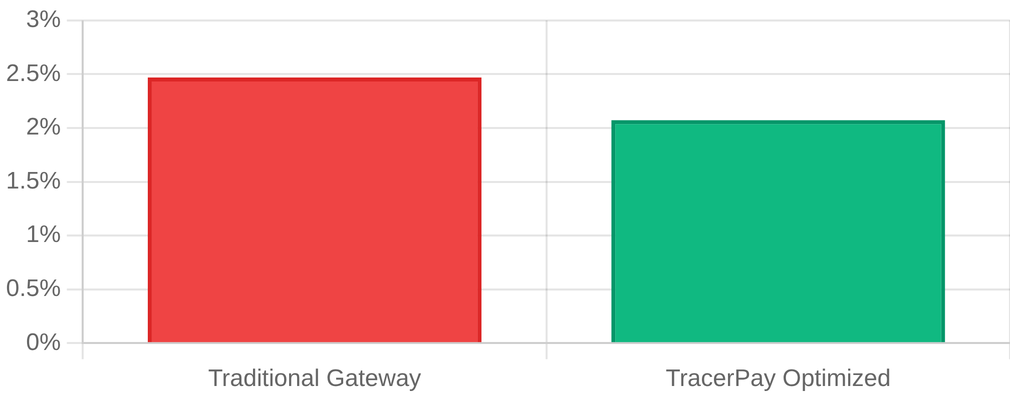
Interchange Optimization
Advantage
Our specialty: Maximizing Level 2 & Level 3 interchange savings
Potential Savings Calculator
Monthly Volume:
$100,000
Current Rate:
2.5%
Automated Optimization
Optimized Rate:
2.1%
TracerPay has automated the tedious and manual process of adding Level 3 data
to each transaction, giving merchants big savings on interchange rates without
anyone lifting a finger.
Monthly Savings:
$400
Annual Savings:
$4,800
Set It & Forget It
Interchange Rate Comparison
Automatic qualification for best rates
Traditional vs TracerPay
Manual Data Entry
❌ Error-Prone
Automated Level 3
✅ TracerPay
Downgrade Protection
✅ Built-In
Level 2 & 3 Qualification
Automatic qualification for the lowest possible interchange rates

Slide 5










Core Features &
Capabilities
Everything you need in one comprehensive payment platform
Interchange Optimization
Modern UX/UI
ACH/Check Processing
Automated Level 2 & 3 data transmission for maximum savings
Beautiful, clean interface that's easy to navigate
Built-in check processing in virtual terminal
3D Secure
Recurring Payments
Secure Customer Vault
Eliminate chargebacks and protect from friendly fraud
"Set it and forget it" subscription-based payments
Tokenized storage for customer payment methods
Invoicing Suite
Fraud Protection
Full White Label
Built-in electronic invoicing for easy payment collection
10 modules with extensive customization options
Complete branding control, not co-branded
All Features. One Platform. Zero Compromises.
TracerPay eliminates the need for multiple vendors by providing every payment feature
your business needs in a single, integrated solution.

Slide 6




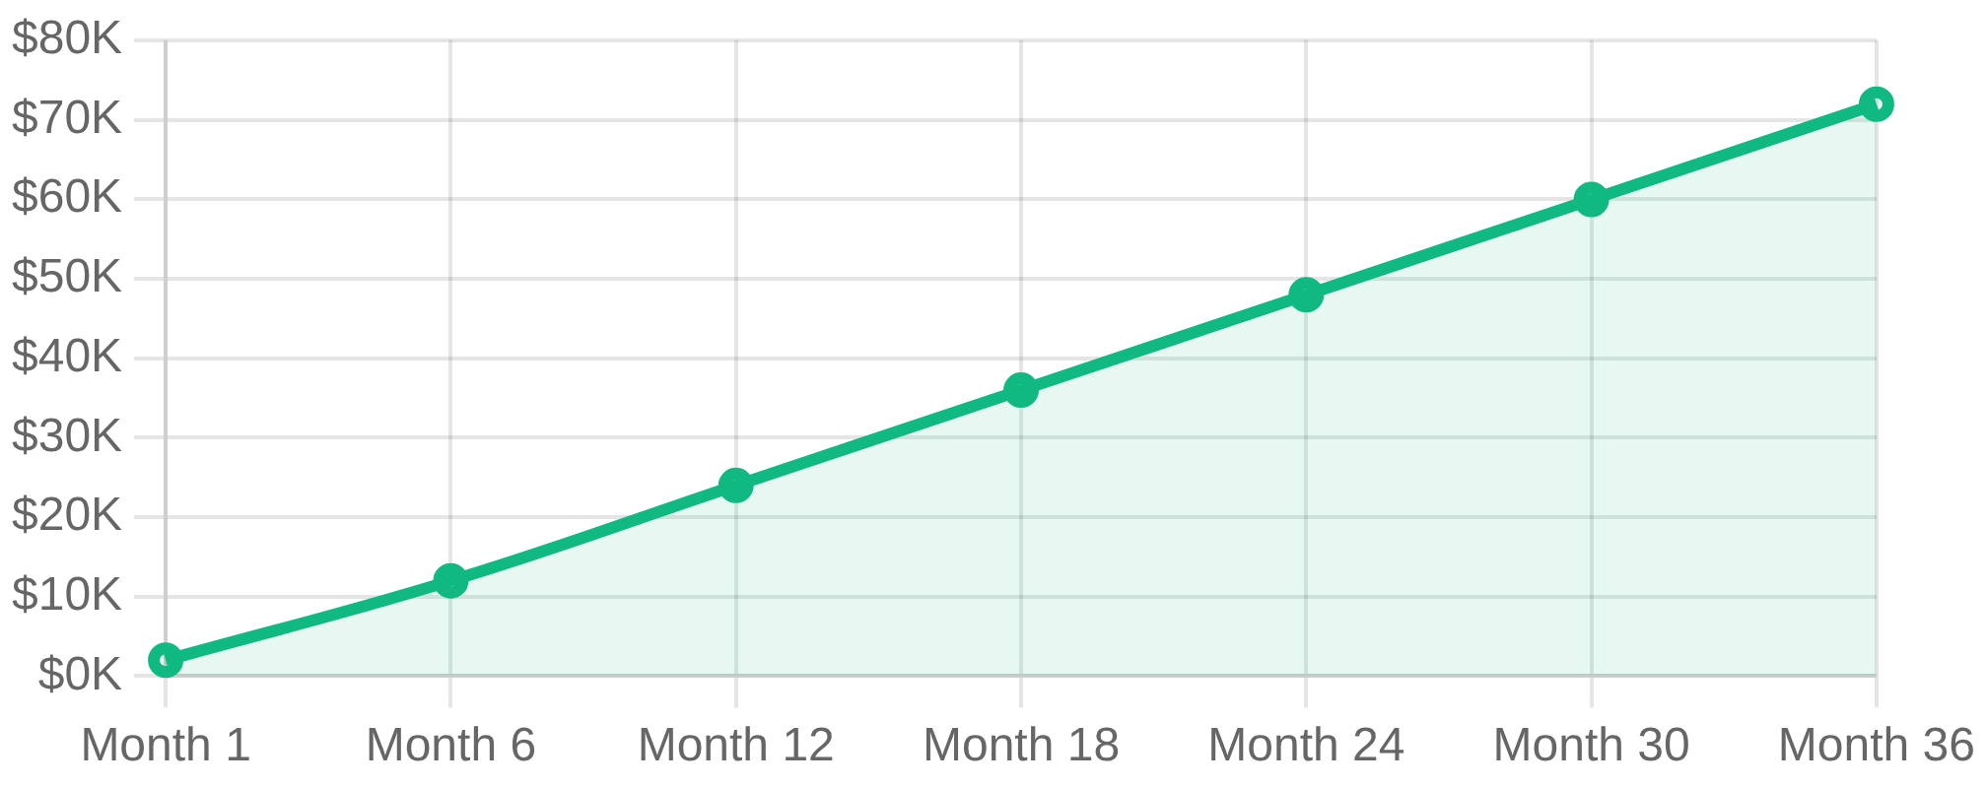
Business Benefits &
ROI
Quantifiable value for merchants, ISOs, and payment processors
Cost Reduction
ROI Calculator
• Reduce interchange fees by 0.4% on average
• Eliminate downgrade penalties
Monthly Volume
Savings Rate
$500K
0.4%
• Lower total cost of ownership
Monthly Savings
Annual Savings
$2,000
$24,000
Merchant Retention
• "Stickier" merchants with white-label branding
3-Year Total Savings
• Improved user experience reduces churn
$72,000
• Comprehensive features eliminate vendor switching
Operational Efficiency
Cumulative Savings Over Time
• Automated processes reduce manual work
• Single platform eliminates integration complexity
• Real-time reporting and analytics
Additional Value
Reduced Chargebacks
Faster Processing
3D Secure protection
Modern infrastructure
Better Support
Brand Strength
24/7 expert assistance
Full white-label control

Slide 7





Competitive
Advantages
How TracerPay differentiates from traditional payment processors
TracerPay vs Traditional Gateways
Technology Leadership
Built from the ground up with modern technology stack, providing superior
performance, reliability, and user experience compared to legacy systems.
Feature
Traditional
TracerPay
Interchange Optimization
❌ Manual
✅ Automated
Specialization Focus
User Interface
❌ Outdated
✅ Modern
Unlike generic processors, TracerPay specializes in interchange optimization
and white-label solutions, delivering superior results in these critical areas.
White Label
⚠️ Co-branded
✅ Full
All-in-One Platform
❌ Multiple vendors
✅ Single solution
Partner-Centric Approach
Fraud Protection
⚠️ Basic
✅ 10 modules
Designed specifically for ISOs and payment processors who need white-label
solutions that strengthen their brand and increase merchant retention.
Support Quality
⚠️ Standard
✅ Expert 24/7
Security Excellence
PCI Level 1 compliance with advanced fraud protection featuring 10 customizable
modules, providing enterprise-grade security for all transaction types.
The TracerPay Difference
While others focus on basic payment processing, TracerPay delivers specialized solutions
that maximize profitability, enhance user experience, and strengthen partner relationships.

Slide 8








Target Markets &
Use Cases
Ideal customer profiles and specific applications for TracerPay
ISOs & Processors
High-Volume Merchants
Software Companies
Independent Sales Organizations
Businesses with significant processing
SaaS platforms and ISVs
White-Label Branding
Cost Optimization
API Integration
Strengthen brand identity with full white-label gateway solutions
Maximize savings through automated interchange optimization
Seamless integration with existing software platforms
Merchant Retention
B2B Transactions
Revenue Sharing
Reduce churn with superior user experience and comprehensive features
Level 2 & 3 data for commercial card transactions
Monetize payment processing as an additional revenue stream
Competitive Edge
Multi-Channel Sales
Customer Stickiness
Differentiate with interchange optimization and modern technology
Unified platform for online, in-store, and mobile payments
Integrated payments increase platform adoption and retention
Ideal Volume:
$1M+ monthly processing
Ideal Volume:
$500K+ monthly processing
Ideal Volume:
Multiple client processing
Industry-Specific Applications
E-commerce
Restaurants
B2B Services
Education
Online retailers with recurring billing needs
Multi-location chains with POS integration
Commercial transactions with Level 3 data
Tuition payments and recurring billing

Slide 9









Implementation &
Support
Seamless onboarding and ongoing partnership success
Implementation Process
1
2
3
4
Discovery & Planning
Setup & Configuration
Integration & Testing
Go-Live & Training
Requirements analysis, integration planning, and timeline development
Gateway configuration, white-label branding, and feature customization
API integration, system testing, and certification processes
Production deployment, team training, and ongoing optimization
Timeline:
2-4 weeks
Timeline:
1-2 weeks
Timeline:
2-3 weeks
Timeline:
1 week
24/7 Expert Support
Integration Options
• Dedicated account management
RESTful API
• Technical support specialists
Modern, developer-friendly integration
• Priority response times
Virtual Terminal
• Proactive monitoring
Web-based payment processing
Mobile SDK
Native mobile app integration
Training & Resources
E-commerce Plugins
• Comprehensive documentation
Pre-built shopping cart integrations
• Video training materials
• Best practices guides
• Regular webinars
Ongoing Partnership
Regular performance reviews
Feature updates and enhancements
Analytics & Reporting
Market insights and trends
• Real-time transaction monitoring
Strategic business consultation
• Detailed performance reports
• Interchange optimization tracking
• Custom dashboard creation
Implementation Timeline: 6-10 Weeks
From initial discovery to full production deployment with comprehensive training and support

Slide 10




Next Steps &
Contact
Ready to transform your payment processing?
Start Your TracerPay Journey Today
Join the growing number of ISOs, processors, and merchants who are maximizing
their profitability with TracerPay's advanced payment gateway solutions.
$24K+
6-10
24/7
Average Annual Savings
Weeks to Implementation
Expert Support
Schedule Your Demo Today
See TracerPay in action and discover how much you could save with our
interchange optimization technology.
Schedule Demo
Schedule a Demo
Speak with Sales
Email Inquiry
See TracerPay in action with a personalized demonstration
Connect with our payment experts for immediate assistance
Send us your questions and requirements for a detailed response
tracerpay.com/demo
1-800-TRACERPAY
sales@tracerpay.com
Your Path to Success
1
Initial Consultation
2
Custom Proposal
Discuss your current processing needs, volume, and optimization goals
Receive a tailored solution with projected savings and implementation plan
3
Technical Review
4
Partnership Launch
Review integration requirements and technical specifications with our team
Begin implementation and start realizing the benefits of TracerPay
TracerPay
- Seamless Payment Solutions Tailored for Your Business
Transform your payment processes with cutting-edge technology and dedicated service

